Slide 1

BRAINVIRE LTD
Personal information Management

Slide 2

About Us
We are P.I.M!
We were hired to take charge of a certain sector called personal information management.
Our end goal is to create a system which stores all personal information securely and efficiently, while keeping it simple for the users.
Who are we? What do we do?

Slide 3

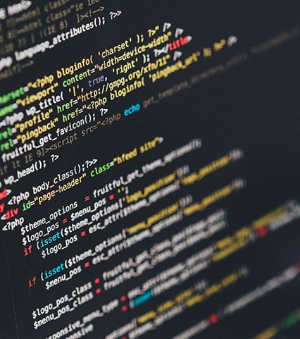


THE TEAM
Our roles
Scott
Co-ordinator & Completer, Finisher
Glenn Callum
Specialist & Shaper Monitor Evaluator
Tony Dafydd
Resourcer & Plant Team worker & Implementor

Slide 4
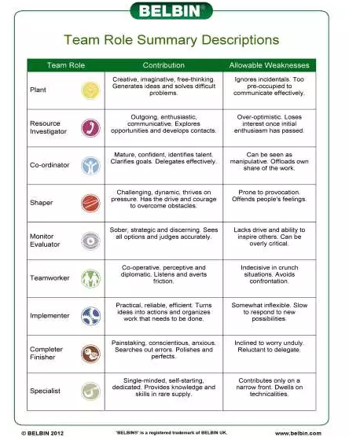
BELBIN
Team Role Summary
T
T
S
G
C
D
D
S
G

Slide 5


QUESTIONS?
Up Coming Slides:
Quality Assurance
Our Policy

Slide 6

QUALITY ASSURANCE
Documentation of reason
Create a Gantt chart that outlines all the tasks that need to be completed. The Gantt chart must have a key to identify what colour means what. For example, green is completed, amber is should be completed by and red is not completed.
GUI will be designed in a way that is easy to understand from outside perspective to where anyone can navigate through the GUI and the GUI will use equal amount of colours.
The users will be directed to the homepage of the GUI it will ask for a Username and Password, this feature must be thoroughly tested to ensure the login system works correctly and is safe and secure.
Admin should be able to login as the admin and have full access to the data within the program whereas the regular user will have restricted access to the information within the program.
The GUI will be tested by each member of the team, to ensure that there are no problems like crashing or leaking important data within the program.

Slide 7

POLICY
Terms & Conditions
Data will be collected, stored and used in a manner that ensures it is relevant, timely, accurate, coherent, transparent and accessible. Everyone in the company must provide all the relevant information before they can even be involved with the company.
Data Protection is the safeguarding of the privacy rights of individuals in relation to the processing of personal data. The Data Protection Act lays down strict rules about the way in which personal data and sensitive personal data are collected, accessed, used and disclosed. The data protection acts also permit individuals to access their personal data on request and confer on individuals the right to have their personal data amended if found to be incorrect.
Sensitive information must be safeguarded against unauthorised disclosure, modification, access, use, Destruction, or delay in service. Data will be assessed and managed to ensure that it is of a quality that is fit for its purpose.

Slide 8




FLOW CHART
Our flow chart

Slide 9
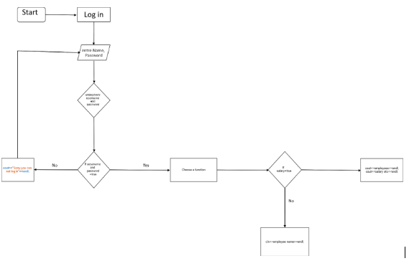

Slide 10
QUESTIONS?
Up Coming Slides:
Gantt Chart
Comparisons

Slide 11
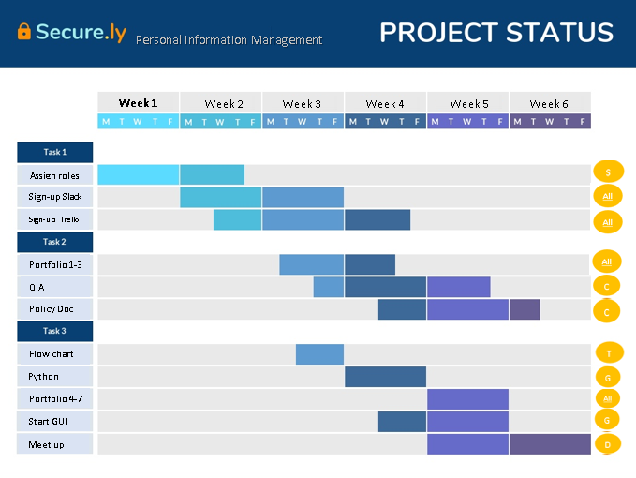
TRACKING OF TASKS
Gantt Chart
WHAT IS IT?
A Gantt chart is a horizontal bar chart which is used in project management, it illustrates our schedule; therefore, we are able to utilise our time efficiently – as it keeps track of what is completed or what needs to be completed. .
Also the chart keeps track of the due dates, which is set by our co-ordinator.
(why we need a gantt chart, what we used it for and how we utilized it ?

Slide 12
IMPLEMENTING A IF STATEMENT
Positives
Negatives
Simple
Short
Easily assessable
Effective
Secure
There is no negatives.
Only when you properly implement an if statement.

Slide 13
C# OR PYTHON
C#
Python
Fast
Experience
More difficult to maintain/write
Object-oriented
object-oriented
dynamically-interpreted
Fewer keywords
object-oriented
Slow

Slide 14
GUI
Information about the GUI

Slide 15
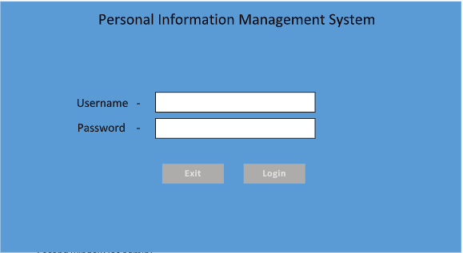
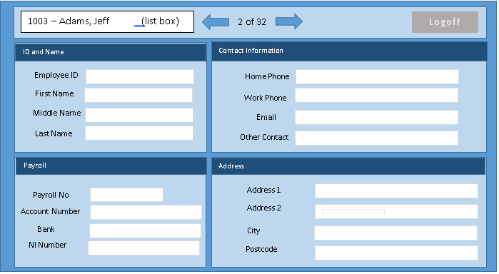
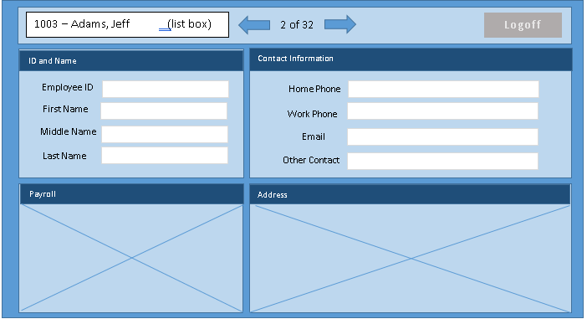

Slide 16

ANY QUESTIONS? IF SO, PLEASE EMAIL US ON: PIM_HELP@BUSINESS.COM OR PHONE US ON: 07539472944

Slide 17



THANK YOU
WWW.Brainvire.COM
P.I.M Team
+44 555‐0199
MMSQ@buisness.com

